Slide 1
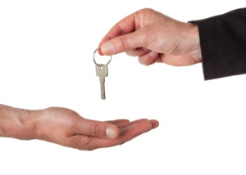
GIVING IS RECEIVING
By
Pr Paul Ang

Slide 2
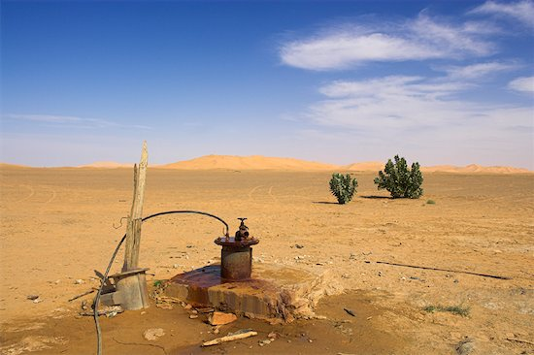
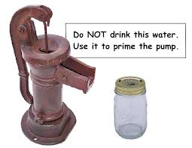
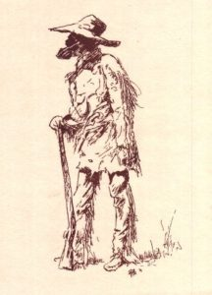
A man lost in desert, dying for thirst & searching for water. Saw a hut ....entered. Excited to see a water pump. As he primed, no water came out.Then he saw a bottle of water corked. Tempted to drink immediately but saw a note." pour the bottle of water into the pump. When you finish drawing the water, please fill the bottle for the next person".
DECISION ...drink or obey the instruction?

Slide 3
Proverbs 11:24-25 (NKJV)
²⁴ There is one who scatters, yet increases more;
And there is one who withholds more than is right,
But it leads to poverty.
²⁵ The generous soul will be made rich,
And he who waters will also be watered himself.
Life be like a waterfall
River Jordon versus Dead Sea
Botanical Garden, Singapore

Slide 4
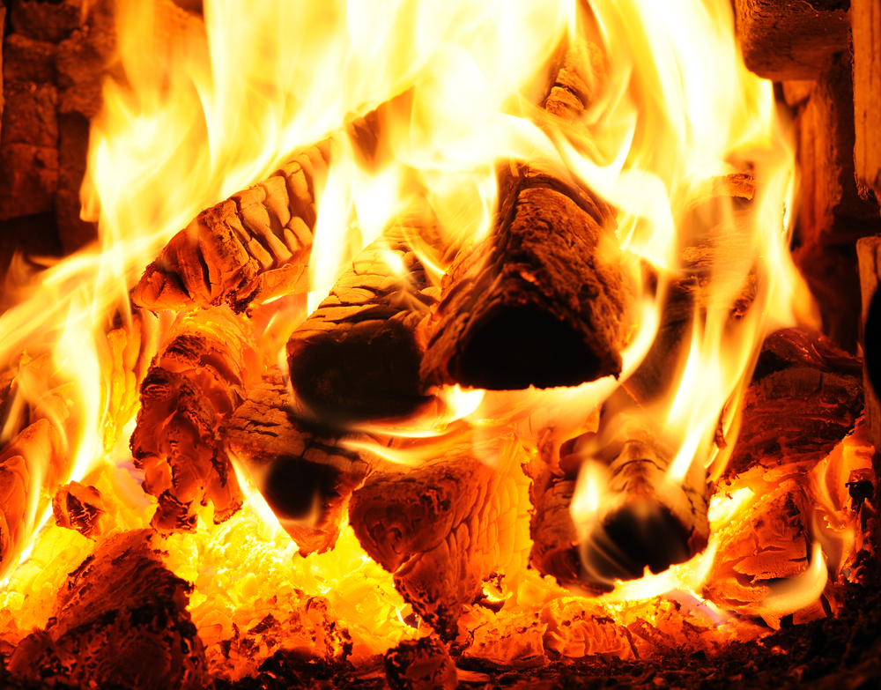
Where there is no wood, the fire goes out; And where there is no talebearer, strife ceases. - Proverbs 26:20 (NKJV)
Give wood, receive fire
No wood, no fire

Slide 5
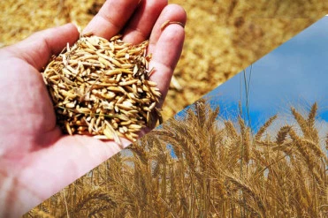
“While the earth remains,
Seedtime and harvest,
Cold and heat,
Winter and summer,
And day and night
Shall not cease.”
Genesis 8:22 (NKJV)

Slide 6
Giving is not just $,
but our time, talent, love, smile, hug, sacrifice...

Slide 7
Then she made a vow and said, “O Lord of hosts, if You will indeed look on the affliction of Your maidservant and remember me, and not forget Your maidservant, but will give Your maidservant a male child, then I will give him to the Lord all the days of his life, and no razor shall come upon his head.”– 1 Sam 1:11 (NKJV)
And the Lord visited Hannah, so that she conceived and bore three sons and two daughters. Meanwhile the child Samuel grew before the Lord. – 1 Sam 2:21 (NKJV)
Edwin Teh
Jonathan Ho#

